Slide 1
SHS LRCII Remote Learning For the week of June 8th
Welcome to our online classroom!

Slide 2
Instructions for Caregivers:
The following daily schedule is intended to run for 3-4 hours (example might be 8am -12pm.) You may run the schedule in it’s entirety or do the pieces you are comfortable with. If you would like a longer learning at home schedule, please let me know and I can give you some options (run the schedule a second time or provide extension activities).

Slide 3
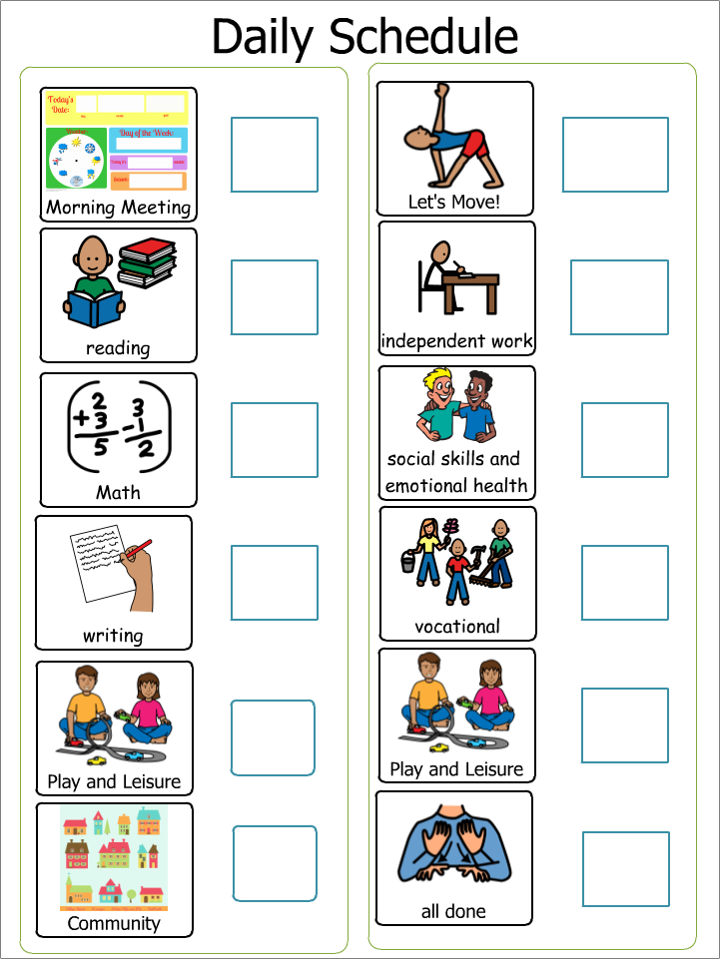
Daily Visual Schedule To make your own daily schedule: CLICK HERE

Slide 4
Morning Meeting/Student Check-In:
*This portion of our day is intended to last about 15 minutes. Please adjust your time based on your child’s needs and abilities.
Morning Meeting:
Do the Morning Meeting Boom Cards: CLICK HERE
Question of the Week:
Provided by SLP/OT (new every Thursday)
CLICK HERE

Slide 5
Teach Time:
Note to Caregivers: The following teach time is intended to last about 60 minutes total. These slides incorporate NEW learning based on your child’s Individual Education Plan (IEP). The following activities include Reading, Writing and Math. They may not exactly match their goals and objectives, but the content is matched as closely as possible. You can choose to do all three activities if you want to extend your child’s online school or choose one per day.
NOTE: CBI = Community Based Instruction

Slide 6
Reading Work: Work for 15 min, break for 5 min (You may also work for the full 20 minutes)
Please follow the links to sign in to your student’s work. Your student should read the book at least ONCE A DAY!
Monday Raz Plus BOOK: Assigned book (LISTEN) | Tuesday Raz Plus BOOK: Assigned book (read) | Wednesday Raz Plus BOOK: Assigned book (read to partner) | Thursday Raz Plus BOOK: Assigned book (read to self) | Friday Quiz from your assigned book

Slide 7
Writing Work: Work for 15 min, break for 5 min (You may also work for the full 20 minutes)
Please follow the link to sign in to your student’s work.
Monday Writing Boom Cards Choose 2 WRITING boom cards assigned to you | Tuesday News 2 You Choose current story for News 2 You | Wednesday Raz Plus VOCABULARY: Assigned book (ONE activity) OR Finish N2Y story | Thursday Raz Plus VOCABULARY: Assigned book (TWO activities) OR Finish N2Y story | Friday End of Week Assignment Write in COMPLETE SENTENCES please!

Slide 8
Math Work: Work for 15 min, break for 5 min (You may also work for the full 20 minutes)
Please follow the link to sign in to your student’s work.
Monday Math Boom Cards Title: Choose 2 decks assigned to you | Tuesday Go to link on Mrs. H's website Title: Using Money | Wednesday Go to link on Mrs. H's website Title: Writing Money Amounts | Thursday Go to link on Mrs. H's website Title: Rounding to nearest dollar DO DOLLAR UP | Friday Bartell Drugs Go to the Bartell Drugs Link (ABOVE): You have $20. Find 3 items you can buy on the weekly ad for $20.

Slide 9
Leisure Time:
Note to Parents: The following Leisure time is intended to last about 20 minutes. This portion of the schedule is to help your child engage in fun activities that can be done with support depending on your child’s needs and abilities.
Choose Activities that Interest your Child, the next slide is an example of a leisure choice menu.

Slide 11
Community:
Note to Caregivers: This portion of the daily schedule will incorporate accessing the community. It is intended to last 15 to 30 minutes, depending on the virtual field trip or video.
Monday Gardener CBI Job video: What does a Gardner Do? | Tuesday Plants Virtual Field Trip NOTE: 20 minutes long | Wednesday 5 Gardening Tips and Ideas | Thursday Backyard Garden virtual field trip | Friday Boom cards Choose 1 set of PLANT related Boom cards

Slide 12
Physical:
Note to Caregivers: This portion of the daily schedule will incorporate accessing some Physical Education. This is VOLUNTARY or access Mrs. Wince’s assignments for the week.
Monday Brain Gym | Tuesday Zumbini with Ms. Natalia Part 1 | Wednesday Brain Gym | Thursday Zumbini with Ms. Natalia Part 2 | Friday Brain Gym

Slide 13
Independent Work Time:
Note to Caregivers: The following teach time is intended to last about 60 minutes total. These slides incorporate work that the student has already mastered. You can choose to do all three activities if you want to extend your child’s online school or choose one per day.

Slide 14
Independent Writing Work: Work for 15 min, break for 5 min (You may also work for the full 20 minutes)
Please follow the link to sign in to your student’s work.
Typing
*Log in and Start Typing!

Slide 15
Independent Math Work: Work for 15 min, break for 5 min (You may also work for the full 20 minutes)
Please follow the link to your student’s work
Happy Numbers
*Log in
*Do “assessment”

Slide 16
Social Skills and Emotional Health:
Note to caregivers: The following time in the schedule is to focus on supporting your child’s social skills and emotional well being and is intended to last about 20 minutes.
Monday SLP/OT current lesson Microsoft TEAMS— Spartan Special Services and Remote Learning | Tuesday How to Make (and Keep) Friends | Wednesday Social Skills-Boom cards Choose TWO social skills activities | Thursday Social Group with Class 12:00 pm | Friday 6:00 Virtual Graduation Michael, Utkarsh, Rose, Chris, James, Rey, Stuart, Ashley ARE GRADUATING!

Slide 17
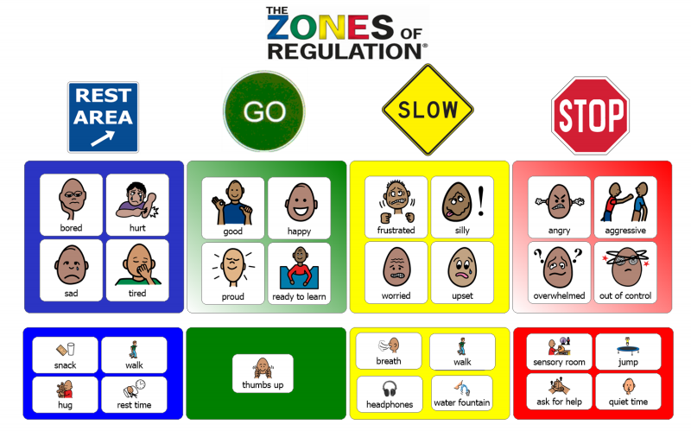
Extra Social Skills Practice:
Practice using this visual throughout your child’s day. Refer to this when they are calm and happy, getting frustrated or having challenging behaviors.

Slide 18
Vocational:
Note to Caregivers: This portion of the daily schedule will incorporate job skills or independent living skills.
Monday Floral Designer CBI Job Video | Tuesday Nursery Workers CBI Job Video | Wednesday Chores Work in the garden OR Plant something | Thursday CBI Vocational Task WRITING PROMPT Go to link on Mrs. H's website | Friday Boom cards Title: Choose 1 set of JOB related Boom cards

Slide 19
Leisure Time:
Note to Parents: The following Leisure time is intended to last about 20 minutes. This portion of the schedule is to help your child engage in fun activities that can be done with support depending on your child’s needs and abilities.
Choose Activities that Interest your Child, the next slide is an example of a leisure choice menu.

Slide 21
Just for FUN!
Note to Caregivers: This portion of the daily schedule is “just for Fun” independent activities
Monday You choose and then tell me at the end of the week | Tuesday Boom Cards Choose 1 set of FUN boom cards | Wednesday You choose and then tell me at the end of the week | Thursday Boom Cards Choose 1 set of FUN boom cards | Friday Do Zumbini or Brain Gym with Ms. Natalia (again!)

Slide 22
Daily Check-OUT
Complete the Microsoft document when you are done for the day! ☺
DAILY check-out

Slide 23
You are all done with Online School Today!

